Slide 1
Information Visualization Project
World Inequality Dataset
Presented by
Malak BRITEL
Omar LARAQUI
Yassir IDHBI
Gabriel BENEVIDES
Tianyi CHEN

Slide 2
MAIN QUESTIONS
Introduction
Radial Stacked Bar Chart: Resource distribution
Bubble chart: Average income & GINI index
Dual Axis Y Line chart: GDP Growth X GINI Index
Dual Axis Y Line chart: Average income X GINI index
Conclusion

Slide 3
Introduction
World Inequality dataset
Aggregation of data
Custom Python code
World Bank database

Slide 4
Radial Stacked Bar Chart Resource distribution
From 1905 to 2016
Different color for different cumul average income
Problem: different way of aggregation for some countries and for some years
Solution: add new aggregation forms to fit all countries data
Animated graph

Slide 6
Bubble chart
Average income & Gini index
The last Average income and Gini index given by each country
Radius represents the Average income in the first graph
Radius represents the Gini index in the second graph
Zoom option

Slide 8
Dual Axis Y Line Chart
GDP Growth X Gini Index
Key question
Can we see a common trend between annual GDP Growth and Gini Index amongst BRICS countries in the 21st century?
In other words
Can we see that growth in an economy is associated with reduction of inequalities?

Slide 9
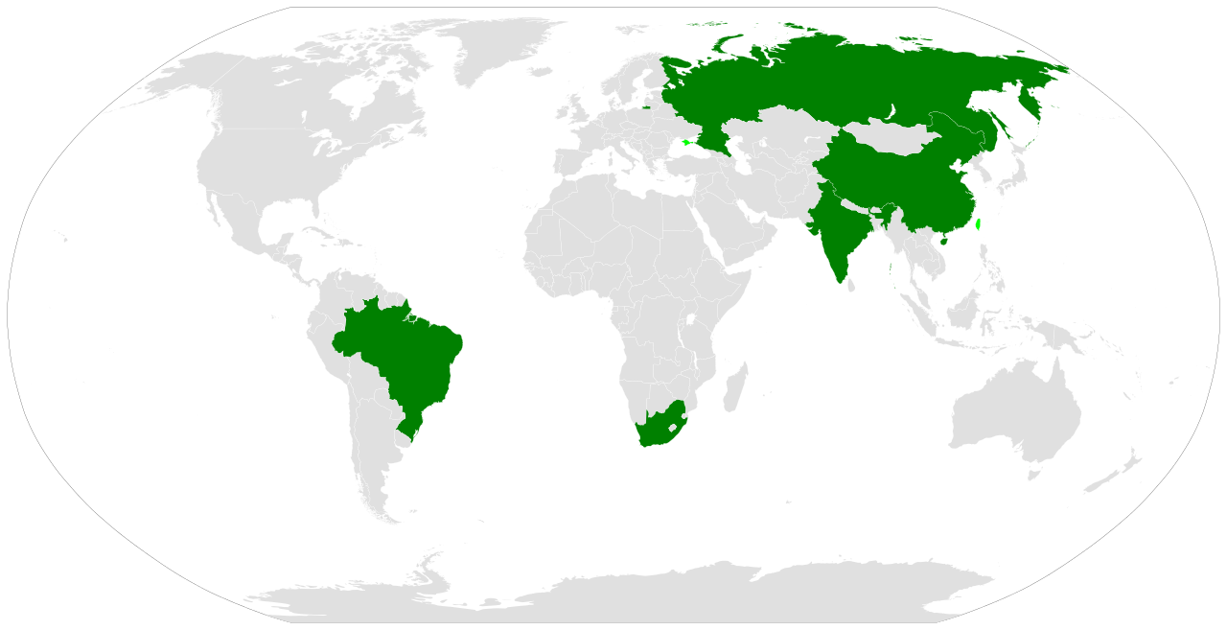
BRICS
BRICS is the acronym coined for an association of five major emerging national economies.

Slide 10
The Visualization
Option to select/unselect one of the BRIC countries or to compare different combinations at the same time.
GDP growth (dashed line) and Gini evolution (solid line) for the period 2000-2015 on the same plot.
Different color for each country.
We hope to then draw some conclusions ...

Slide 12

Few comments on the Data Set
Initial objective to Visualize in the same context annual GDP growth (originally not-available) and GINI index change. (originally available).
Gini Index data missing for South Africa.
Source of GDP Growth Data: World Bank Open Database
Aggregation of the Data using Python.

Slide 13
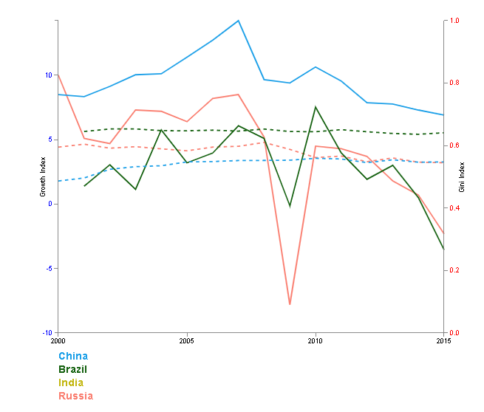
Conclusion

Slide 14
Dual Axis Y Line Chart
Average income X Gini index
Compare Gini index and Average income
Dual Y axis
Dropdown to select the country
The decrease of 2008
No general conclusion

Slide 16
Conclusion
We tried to elucidate the world’s inequalities by drawing the different visualizations
We faced difficulties concerning the non-homogeneity of data

Slide 17
Sources
https://d3js.org/
https://getbootstrap.com/docs/4.4/getting-started/introduction/
https://observablehq.com/@d3/radial-stacked-bar-chart
https://bl.ocks.org/alokkshukla/3d6be4be0ef9f6977ec6718b2916d168
https://bl.ocks.org/d3noob/e34791a32a54e015f57d

Slide 18
THANKS!
Any questions?

